Slide 1

Braess’s Paradox
CSCI 39575 Graph Theory
Based on this paper on Selfish Routing
Notes:
In the future: Slides to add – Lewis-Mogridge position, Jevons Paradox, Downs-Thomson paradox, more selfish routing and POA costs 4/3 for Braess

Slide 2
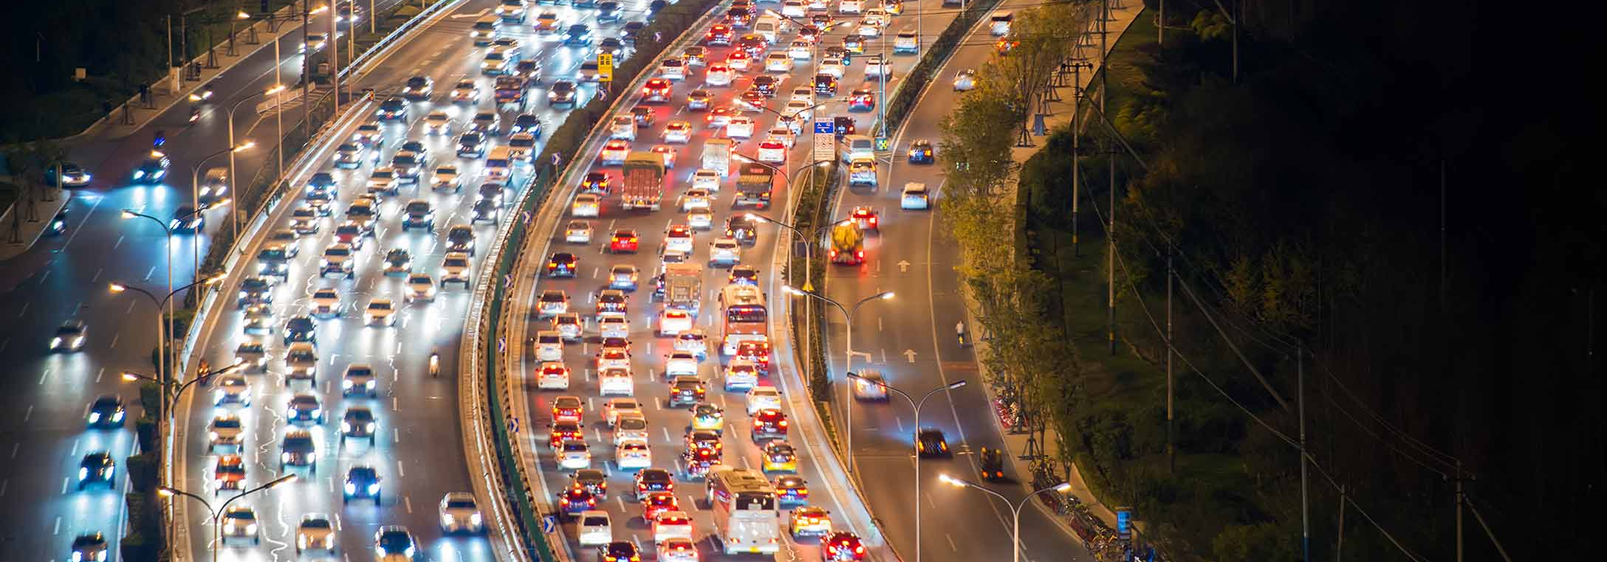
One of the greatest evils…
Traffic

Slide 3

How does traffic happen?
Check out this video to understand where gridlock traffic comes from (phantom intersections)
30% of traffic comes from drivers looking for parking
85% of cars in some large cities transports only one person
Generally, there’s congestion wherever there are human drivers
Check out this Ted Talk for a future driverless city vision (Statistics pulled from this video)
Notes:
Watch from 10 minutes

Slide 4
What are the solutions?
Creating more roads
Does this actually work?
Penalizing tailgaters
Self driving cars
More public transportation
Generally, negative reinforcement isn’t loved by the masses
This is still in its infancy
Does this actually work?

Slide 5

Can adding more roads actually cause more trouble?
In order to look at this, let’s first look at a very simple example of a road network called Pigou’s Example

Slide 6
Who was Arthur Cecil Pigou? 1877 - 1959
An English economist who trained and influenced many Cambridge economists
Covered many fields of economics such as
Welfare
Business cycle theory
Unemployment
National output
And apparently, he toyed with traffic congestion/selfish routing

Slide 7
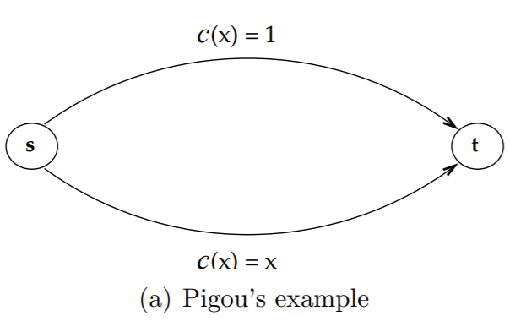
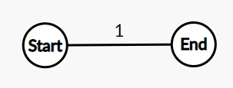
Pigou’s Example
Let’s say you have a road like this:
Regardless of the number of vehicles, the total time to get from start to the end is 1
What happens if we introduce another road that looks like this?
Notes:
Go to onenote and explain how average rate should be ¾ but it is still 1 for drivers who want the most optimal path

Slide 8
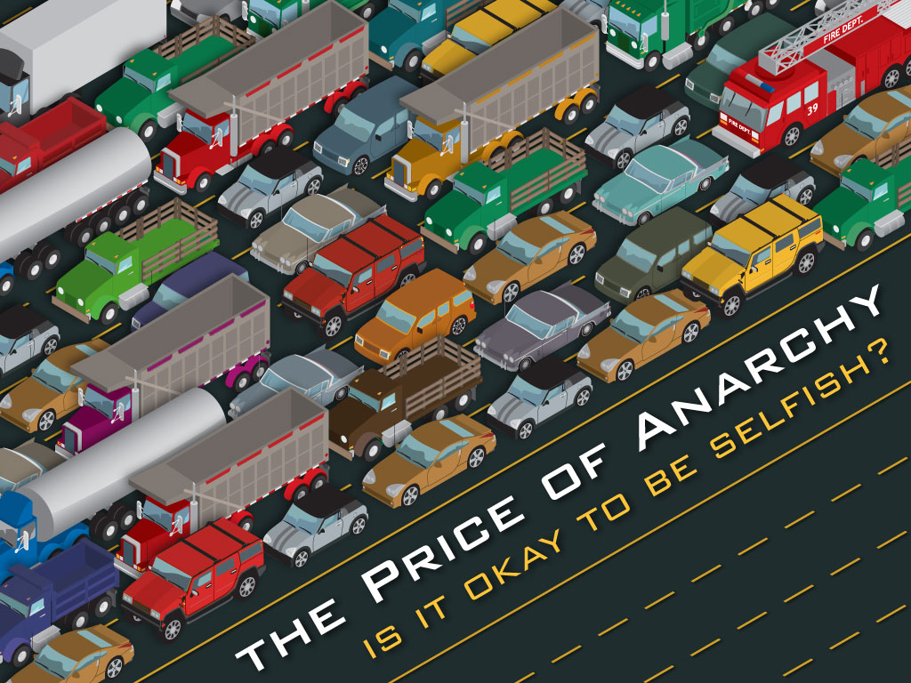
The price of anarchy
Sometimes, adding a road doesn’t actually make traffic better
In fact, there are situations where it makes traffic worse!
All of this has to do with the idea of the price of anarchy (POA)
The POA determines just how much the efficiency of a system degrades due to selfish behavior of its agents
In the world of GPS, Google Maps and Waze, you can assume that everyone is selfish
Notes:
Picture has a link

Slide 9

Nash equilibrium
POA comes directly from the concept of a Nash equilibrium
A Nash equilibrium is the most common way to define the solution of a non-cooperative game involving two or more players
In other words, this is the case where you can’t improve your own chances without help from someone else

Slide 10
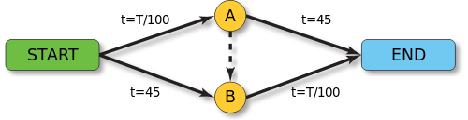
A more complex road network
Now instead of one road with two streets imagine this:
Notes:
Braess’s Paradox

Slide 11

A physics variation to Braess
Check out Up and Atom’s amazing video on Braess’s paradox

Slide 12
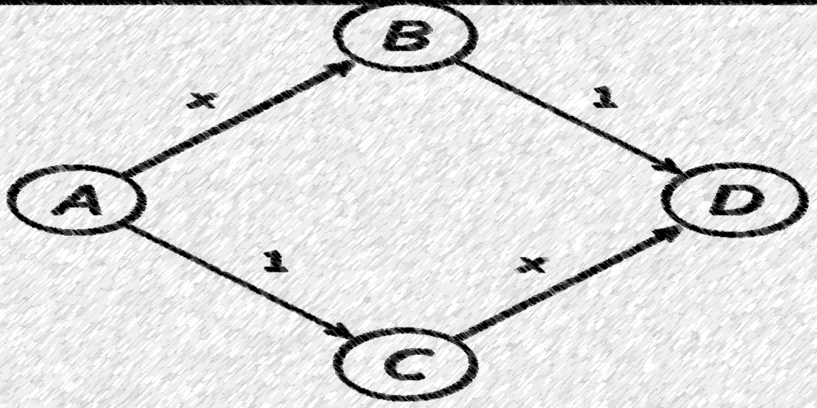
Nash Equilibrium on a simpler route
Traffic will naturally follow a Nash Equilibrium (NE) here
What this means is that no one driver can switch paths to get to their destination faster
The NE exists at ½ of the drivers taking each route (ABD and ACD)
The average cost here is 3/2
If there is a different proportion (i.e. 1/3 and 2/3) it is not a NE

Slide 13
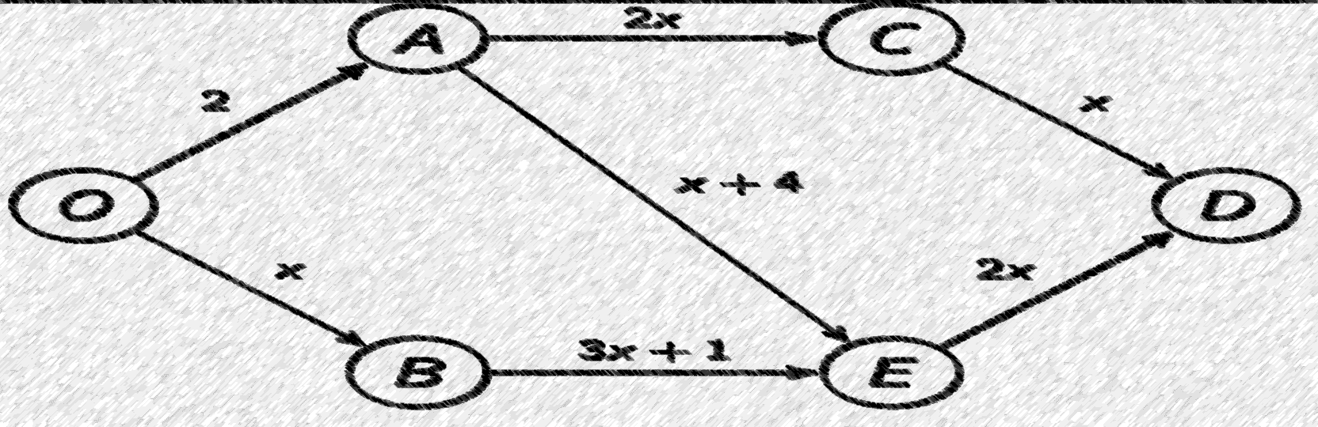
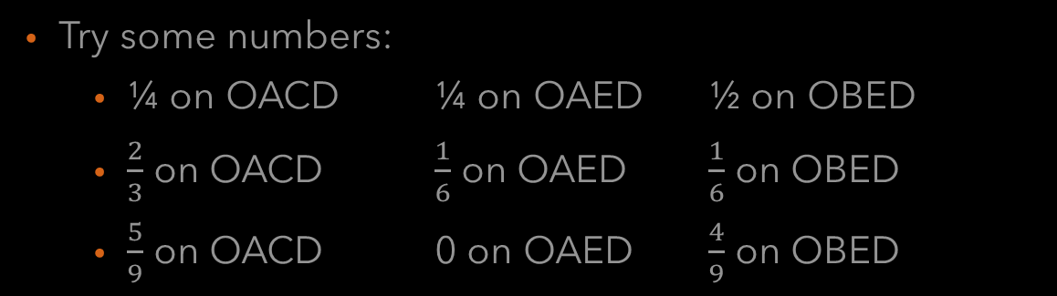
Is there a Nash Equilibrium on the following?
Try some numbers:
¼ on OACD ¼ on OAED ½ on OBED
$\frac{2}{3}$ on OACD $\frac{1}{6}$ on OAED $\frac{1}{6}$ on OBED
$\frac{5}{9}$ on OACD 0 on OAED $\frac{4}{9}$ on OBED
Notes:
Values: 2 ¾, 7 ¾, 4 ½
4, 6 5/6, 2 2/6
3 6/9, 0* 6 8/9, 3 6/9
Nash Equibrium exists at 5/9 taking OACD 0 on OAED and 4/9 on OBED
They both take 3 6/9ths each.

Slide 14
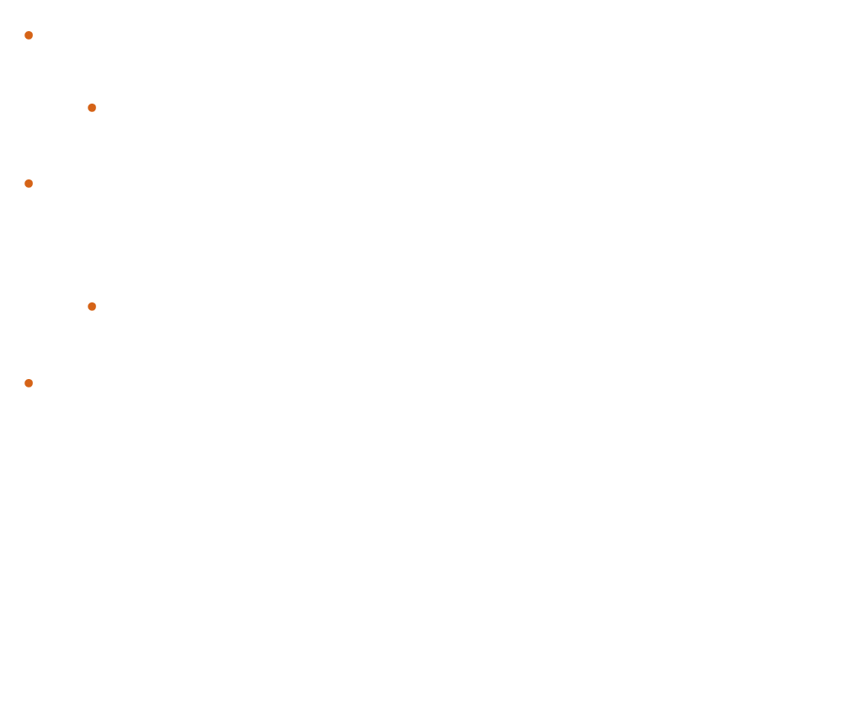
What happens if we double the driver mass?
Try our past solution times 2…
$\frac{10}{9}$ on OACD 0 on OAED $\frac{8}{9}$ on OBED
Doubling the equilibrium traffic doesn’t work but…
$\frac{11}{9}$ on OACD 0 on OAED $\frac{7}{9}$ on OBED
Does work…
Notes:
NE on $\frac{11}{9}$ on OACD 0 on OAED and $\frac{7}{9}$ on OBED
Doubling the equilibrium traffic doesn’t work, this aint Chem!

Slide 15
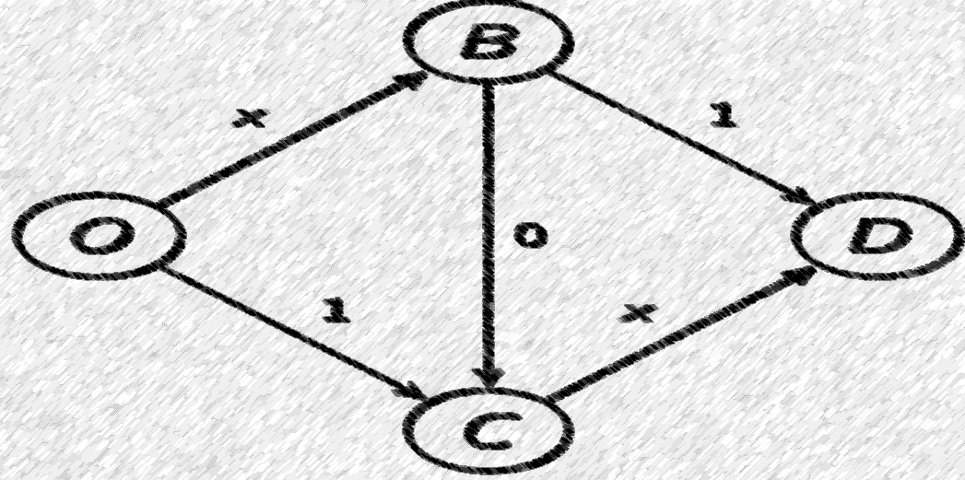
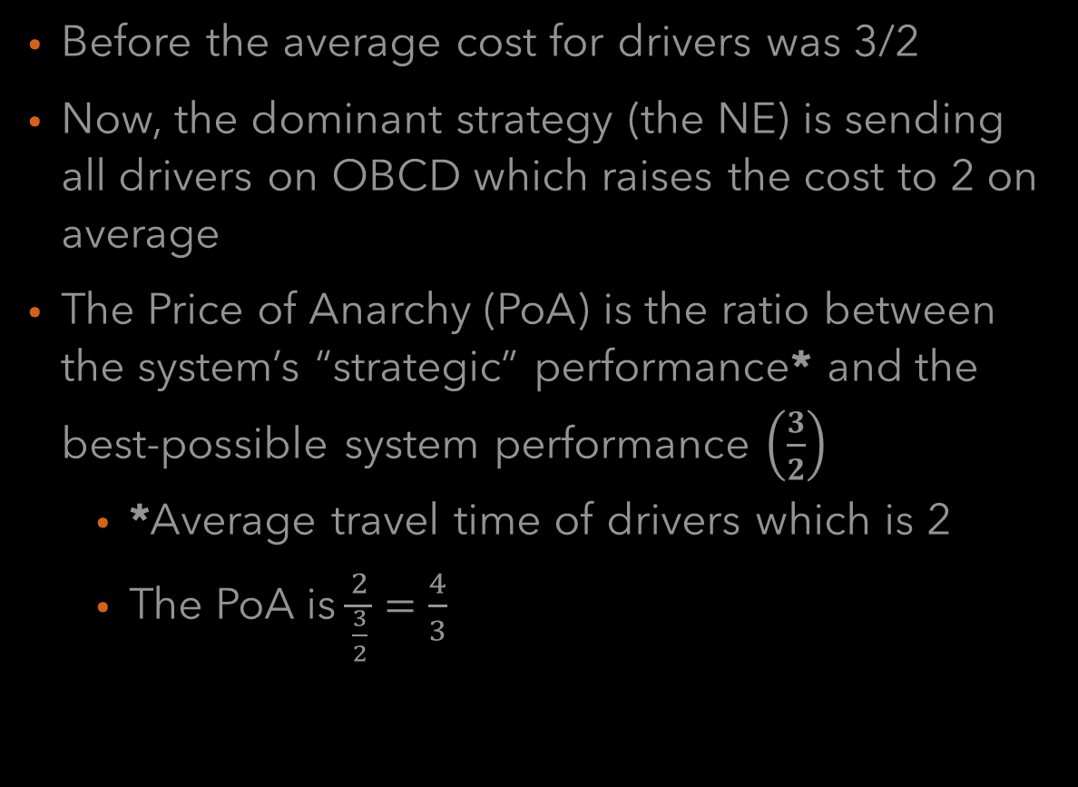
Adding the middle road to our simpler route
Before the average cost for drivers was 3/2
Now, the dominant strategy (the NE) is sending all drivers on OBCD which raises the cost to 2 on average
The Price of Anarchy (PoA) is the ratio between the system’s “strategic” performance* and the best-possible system performance $\left(\frac{3}{2}\right)$
*Average travel time of drivers which is 2
The PoA is $\frac{2}{\frac{3}{2}}=\frac{4}{3}$

Slide 16

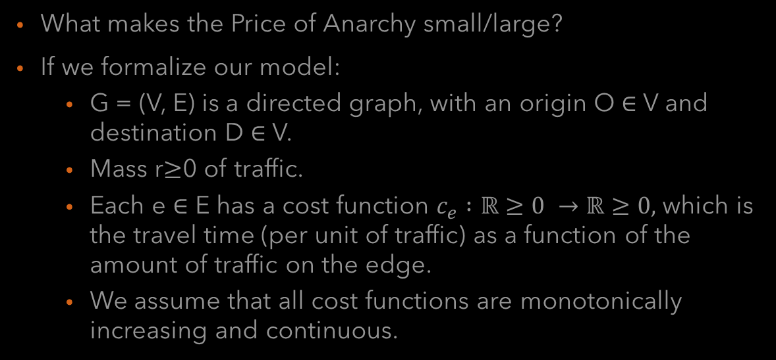
About the PoA
What makes the Price of Anarchy small/large?
If we formalize our model:
G = (V, E) is a directed graph, with an origin O $∈$ V and destination D $∈$ V.
Mass r$≥$0 of traffic.
Each e $∈$ E has a cost function $c_{e} :\text{ℝ}≥0 →\text{ℝ}≥0,$which is the travel time (per unit of traffic) as a function of the amount of traffic on the edge.
We assume that all cost functions are monotonically increasing and continuous.

Slide 17
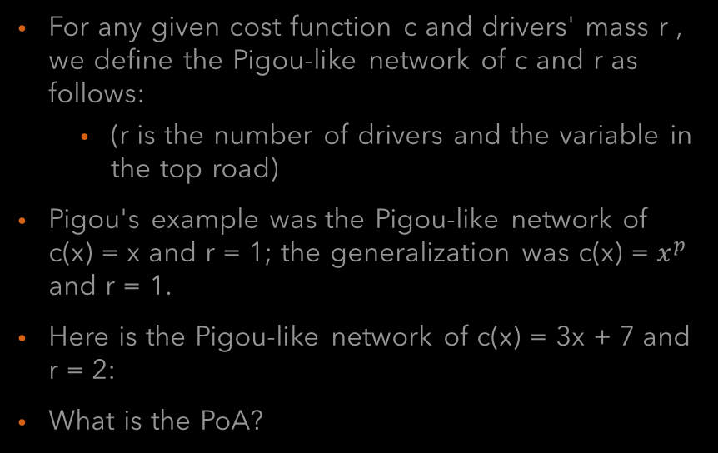
Recall Pigou-like networks
For any given cost function c and drivers' mass r , we define the Pigou-like network of c and r as follows:
(r is the number of drivers and the variable in the top road)
Pigou's example was the Pigou-like network of c(x) = x and r = 1; the generalization was c(x) = $x^{p}$ and r = 1.
Here is the Pigou-like network of c(x) = 3x + 7 and r = 2:
What is the PoA?
Notes:
The NE gets all traffic on the lower edge, with an average travel time of
3 2 + 7 = 13 and a total travel time of 2 13 = 26.
Altruistic dictator gets: min0x2 (2 􀀀 x) 13 + x (3x + 7). Simple
calculus gives that minimum is obtained when x = 1, and it is 23.
The PoA is 26
23 . Note that ratio between the total travel times is the same
as the ratio between the average travel times.

Slide 18
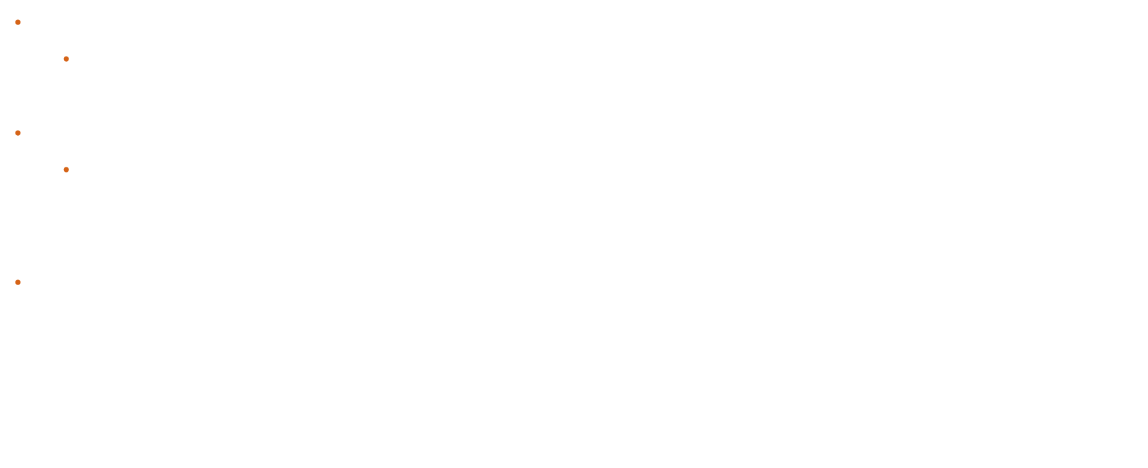
What’s going on? The Pigou Bound
It turns out that there is an upper bound $α(𝒞)$ called the Pigou bound
$𝒞$ is the set of all possible cost functions (we assume they’re monotonically increasing and continuous)
We can see it emerging by calculating the Pigou-like PoA
The PoA can be found with optimal paths, but also with a little calculus:
$$\frac{rc\left(r\right)}{\min_{0≤x≤r}xc\left(x\right)+(r−x)c(r)}=\max_{0≤x≤r}\frac{rc(r)}{xc\left(x\right)+\left(r−x\right)c(r)}$$
Because c is monotonically increasing, theoretically $α(𝒞)$ can be calculated by finding the maximum ratio between the strategic and optimal paths or:
$$for all x>r : x(c\left(x\right)+\left(r−x\right)c\left(r\right)=\left(x\left(c\left(x\right)−c\left(r\right)\right)+rc\left(r\right)\right)≥rc\left(r\right)$$
$$=α\left(𝒞\right)= \max_{c∈𝒞, r≥0, 0≤x≤r} \frac{rc(r)}{xc\left(x\right)+\left(r−x\right)c(r)}$$

Slide 19


Slide 20
This leads us to a Theorem
The worst-case PoA already occurs in a Pigou-like network.
Cost functions are more important than topology.
The PoA in any network with cost functions in $𝒞$ is than or equal $α\left(𝒞\right)$

Slide 21
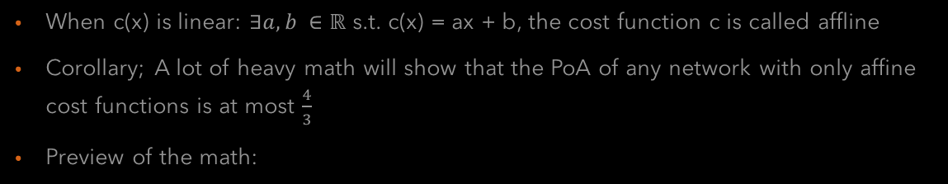
Affine costs
When c(x) is linear: $∃a,b ∈\text{ℝ} \text{s}\text{.}\text{t}\text{. }\text{c}\text{(}\text{x}\text{) = }\text{ax}\text{ + }\text{b}$, the cost function c is called affline
Corollary; A lot of heavy math will show that the PoA of any network with only affine cost functions is at most $\frac{4}{3}$
Preview of the math:

Slide 22
Polynomial costs
The closer we are to linear, the smaller the PoA
Quartic functions have been proposed as a reasonable model of road traffic in some situations
PoA would be approximately 2.2

Slide 23

What is all of this?
All of this stems from something called a potential game which is a subcategory of flow networks
(combination of physics, math, graph theory and game theory)
Every agent tries to minimize their own travel time and they’re all optimizing an implicit potential function

Slide 24
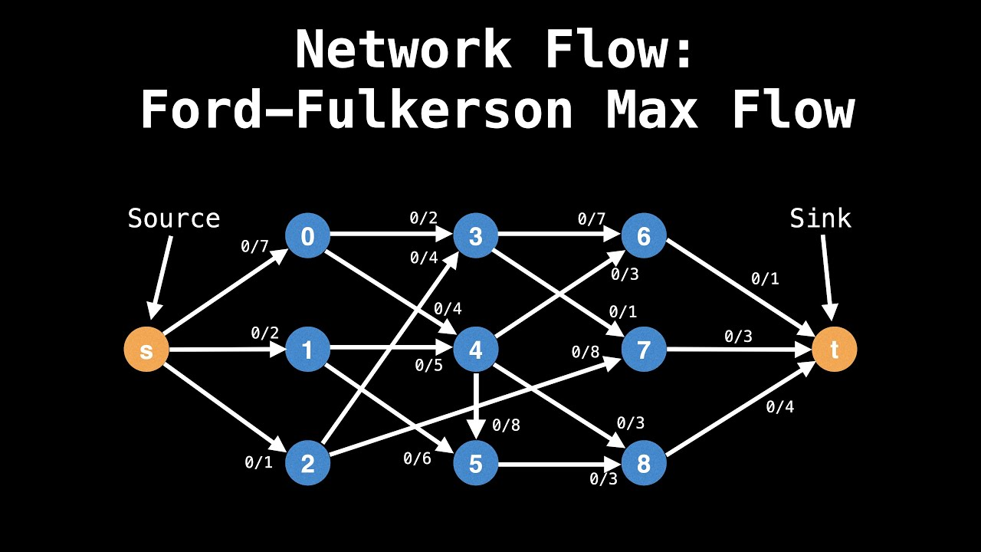

Slide 25
In our case:

Slide 26
An example of the potential function in action:

Slide 27
Reducing the total energy:

Slide 28
The potential function’s special property
Beneficial deviations strictly decrease the potential function
If a flow is not NE, it does not minimize the total enengy
A flow that does minimize the total energy is an NE!
There are finitely many flows in the atomic model
In any atomic routing network, there exists a NE

Slide 29
There is even an algorithm for this

Slide 30

A note on auctions
If you recall, there are a lot of possible auctions out there
I posit that flow has a role in auctions as well, except that there are two competing flows
The self-interest of the bidders to minimize their cost
The self-interest of the sellers to maximize their profit
There are two cases where both are extremes, when the buyers are an oligopsony and when the sellers are an oligopoly
Notes:
Oligopsony: few buyers and they collude
Oligopoly: few sellers and they collude

